Slide 1
Race and Ethnicity as
Social Determinants of Health
CHNA 20 General Meeting
July 20, 2017

Slide 2
Overview
Why would we look specifically at race as a health determinant?
How does race show up as a health determinant in our cities and towns? Communities? Region? State?
What can we do to address race as a health determinant?

Slide 3
Source: 2016 Minnesota Campus Compact, What’s in Your Fish Bowl?
Notes:
All people have culture. Culture goes beyond race, ethnicity or social identity. There may be aspects of our cultures that have been invisible to us, however, because we have been swimming in them all our lives. Even if we now see our cul-tures more clearly — and see ways in which our exposure was limited — the cultural spaces we are raised in shapes us as adults.
Often we do not have opportunities to think, talk, or share about the complexity of our cultures and backgrounds. Today we will.
Provide attached handout with the fish bowl image.
Direct participants to respond to the follow-ing prompts by writing on the inside of the bowl. Note that they will not have to share everything they write and can decide what they choose to keep private.
1. Describe your culture (in whatever way you define that) as it shaped your life and world view in your early years. What values guided your life?
2.Who were “your people” when you were growing up? How did being part of your family/group/community shape and form you?
Note: it can be helpful to share some brief examples from your own life, e.g., various groups of people you list inside the bowl.
Direct participants to write on the outside of the bowl:
1.Who were the people outside of your group? How did you become aware of them; how did you feel toward them; and what experiences influ-enced your feelings?

Slide 4
Example
Losing a family member while young
Taking Transit since HS
Renter
Graduate School degree
Raised Catholic
Time spent outdoors
Agnostic
Irish/German descent
White
Heterosexual
Stable family life
Athletic
Introvert
Safe neighborhoods
Attended Private School
Middle income family

Slide 5
Who am I? What is happening here?
I am not the expert in the room but I am actively involved in addressing our responses to disparities, especially those that are racially driven.
I am part of team working at the intersection of public health and municipal and regional planning
This presentation is meant to launch us forward; leading with race, but not meant to stop there
Conversations concerning race are difficult

Slide 6
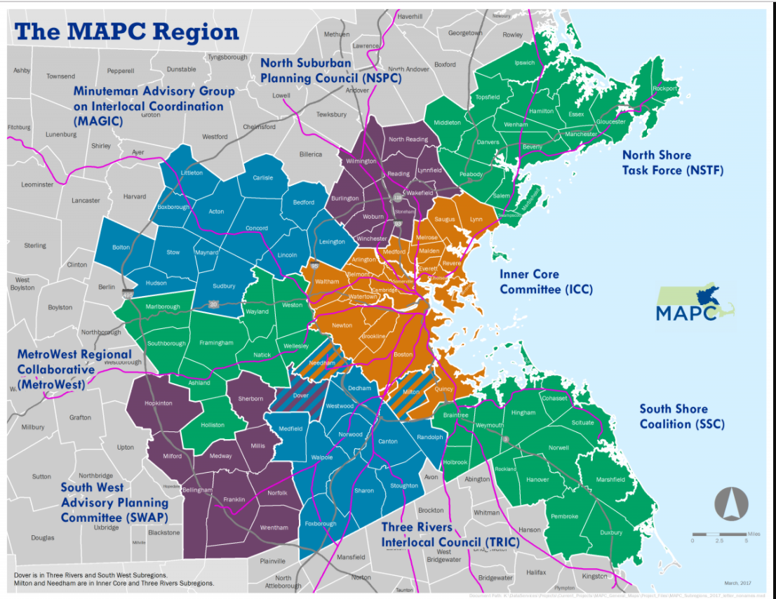
Who is MAPC?

Slide 7
Why Race?

Slide 8
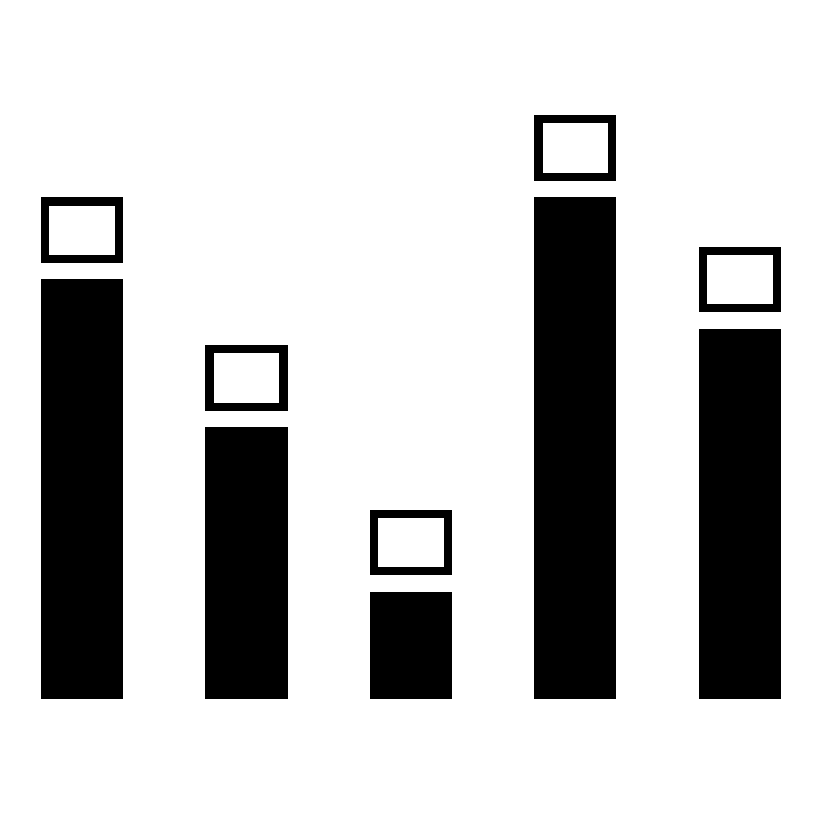
Why Race?
Evidence demonstrates persistent differences in opportunity, quality of life, and health outcomes across racial and ethnic groups
Not due to biological differences, and cannot be explained solely by socioeconomic status or education

Slide 9

Why Race?
Proposition: We must address in order to achieve equity:
All people have full and equal access to opportunities that enable them to attain their full potential

Slide 10
Why Race and Health?
Health is a basic measure of wellbeing and racism—of all kinds—has clear, measurable health impacts.
Measures of health are systematically collected, and health experts have the tools and knowledge to bring to light the disparities resulting from racism simply and powerfully.
Population health is not just impacted by the health system, nor does it impact the health system alone.
Notes:
Health is a basic measure of wellbeing. This is rather intuitive: we are all preoccupied with our own health and want to be healthy and when we are not, it is clear how valuable health is to our basic ability to participate in society. Racism—of all kinds—has clear, measurable health impacts. These often manifest as health inequities. Measuring and monitoring these can then serve as a catalyst for change, guide for targeted improvement, and marker of progress.
Second, measures of health are systematically collected, and health experts have the tools and knowledge to bring to light the disparities resulting from racism simply and powerfully.
Third, population health is not just impacted by the health system, nor does it impact the health system alone. For example, an increasing population of older adults will impact labor, transportation, and housing priorities as well as social security spending and vice versa.
.”

Slide 11
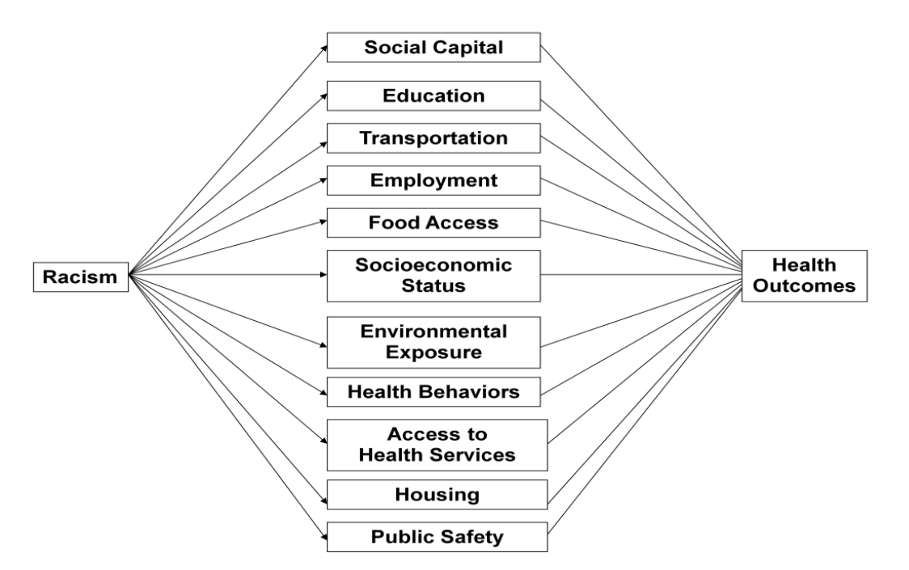
What does it do?
Racism is a force that restricts socioeconomic attainment
Focus on four mechanisms
Not discrete since part of system, but will focus on individually
Source: Boston Public Health Commission, The Racial Justice and Health Equity Initiative, 2015 Overview

Slide 12

Unequal Rates of Exposure to Early Childhood Adversity

Slide 13

The Same Level of Education Provides Unequal Economic Returns across Race

Slide 14



Disproportionate Exposure to Psychosocial and Environmental Stressors

Slide 15

Interpersonal Racism

Slide 16
Source: 2016 Minnesota Campus Compact, What’s in Your Fish Bowl?

Slide 17
How does race show up as a health determinant?

Slide 18
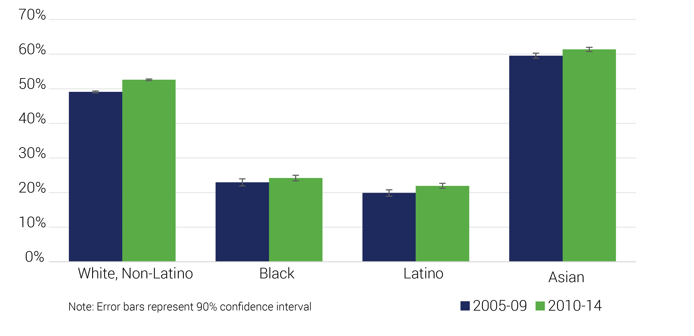
Disparate educational attainment
Educational Attainment by Race
2005-09 and 2010-14, MAPC Region
Data Source: American Community Survey 5-Year Estimates, U.S. Census Bureau
Notes:
One of the best ways to move up the income ladder is to get a college degree. Adults with a bachelor’s degree make double those with just a high school diploma, and more than double those without a diploma.
Yet, as this chart shows, the region has major gaps in bachelor’s degree attainment by race.

Slide 19
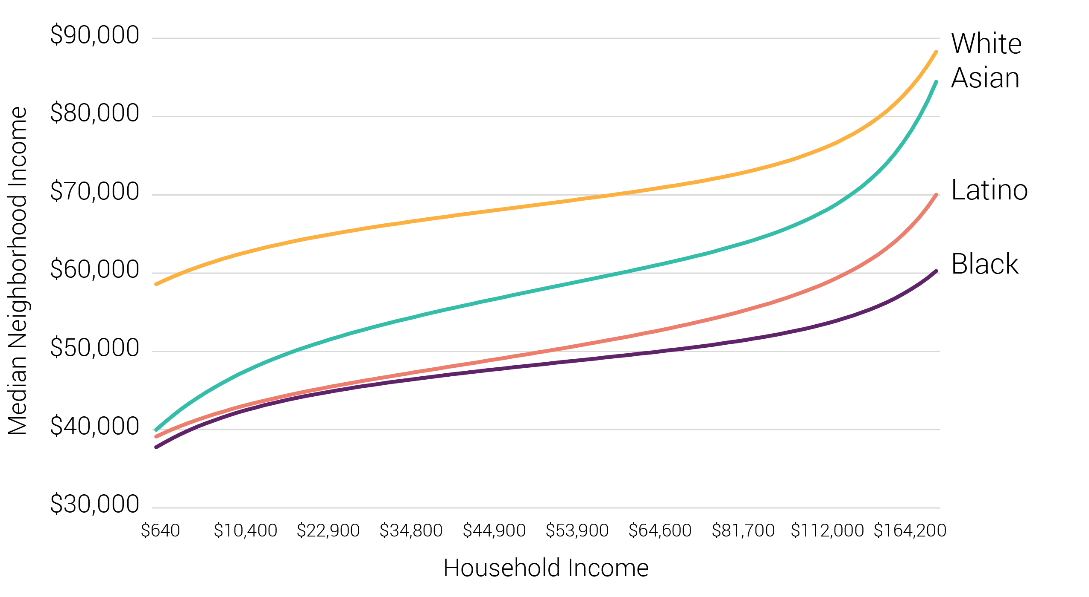
Segregation across incomes
Neighborhood Median Income by Household Income and Race/Ethnicity
2010-14, Boston-Quincy Metropolitan Division
Data Source: Stanford Center
for Education Policy Analysis
Notes:
At the same time as the region has become more diverse, it has become more racially and economically segregated. The 2011 State of Equity found that Metro Boston is among the most segregated regions in the country. Of 100 large metropolitan areas, Boston ranked 13th most segregated for Black and White residents, 9th most segregated for Asian and White residents, and 6th most segregated for Latino and White residents.
In this update, we see, too, that the region is becoming more and more economically segregated, so that lower-income households are becoming more concentrated with less income diversity.
The confluence of the racial and economic segregation is what you see on this slide. This chart shows neighborhood median income by household income for Black, Latino, Asian and White households. Along the y-axis, you see median neighborhood income, and along the x-axis you see household income. Each line represents the income of a household headed by someone of one of these four race or ethnicities, and the corresponding likely median income in their neighborhood. So here, you see that a White household with an income of about $10,000 is likely to live in a neighborhood where the average income is over $60,000. A Black or Latino household making $10,000 is likely to live in a neighborhood with a median household income of just over $40,000. On the higher end, a White household making about $80,000 is likely to live in a neighborhood with a median income of about $75,000, whereas a Black household making $80,000 is likely to live in a neighborhood with a median income of about $50,000.
The trend for Asian households shows that lower-income Asian households tend to live in neighborhoods with incomes similar to Black and Latino households, but high-income Asian households tend to live in more affluent neighborhoods, more similar to the trend for Whites.
The disparities in these trends have increased since 2000.

Slide 20
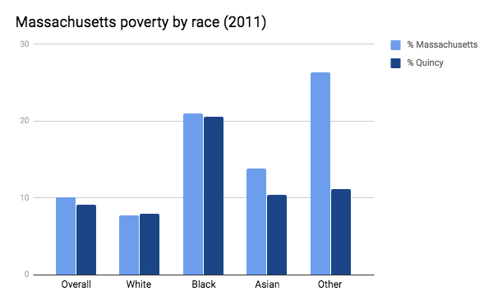
Poverty
Massachusetts overall has lower poverty rates than the US average.
Asian/PI and other minorities have higher poverty rates in MA than the US overall.
Black and White populations have lower poverty rates in MA than US overall.
Black NH make-up 6.1% of the total MA population, but make up 13% of the total poor. Conversely, White NH are 83% of the total population, but only 64% of the poor.
Notes:
http://scholarworks.umb.edu/cgi/viewcontent.cgi?article=1055&context=csp_pubs

Slide 21
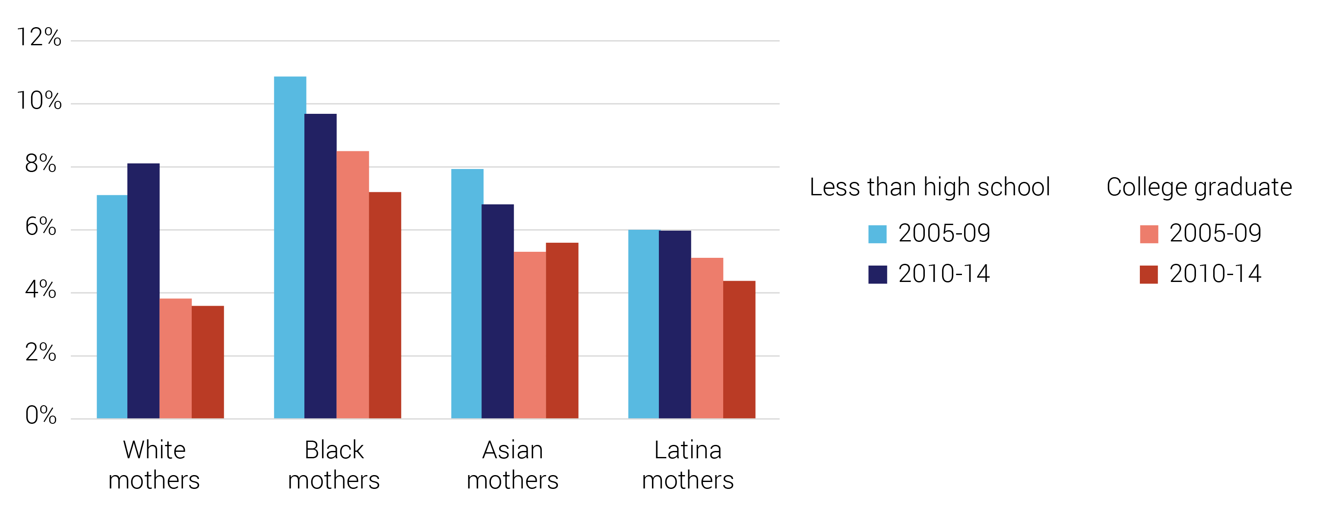
Low birth weight
Low Birth Weight by Mother’s Race and Ethnicity and Education
2005-09 and 2010-14, MAPC Region
Data Source: Massachusetts Department of Public Health
Notes:
One of the most important early indicators of childhood health is birth weight. Low birth weight of less than 5.5 pounds has been associated with educational and developmental delays and adult health problems. Social and environmental conditions increase the risk of having a low birth weight baby, regardless of a mother’s individual risk factors.
In 2011, the disparities demonstrated in low birth weight by race and educational attainment were striking.
This chart shows:
Less than high school on your left in blue: light blue is older data, from 2005-09, darker blue is most recent data available, 2010-14
College graduate on your right in red: light red is older data, from 2005-09, darker red is most recent data available, 2010-14
Within each racial and ethnic group, there are higher rates for mothers without a high school diploma and lower rates for mothers with a college degree
Comparing across race and ethnicity, Black mothers have the highest rates at both educational attainment levels (and this carries through with other attainment levels)
Some good news, though, for most women of color low-birth weight rates have declined since 2005-09, so you can see here, for Black mothers without a high school diploma, Black mothers with a college degree, Asian mothers without a high school diploma, and Latina mothers with a college degree, the rates in 2010-14 are all lower than they were in 2005-09. White women without a high school diploma saw an increase in low birth weight rate, so not all the news is positive.
Where we have seen improvements though, the implications are good for the future of the region’s children.

Slide 22
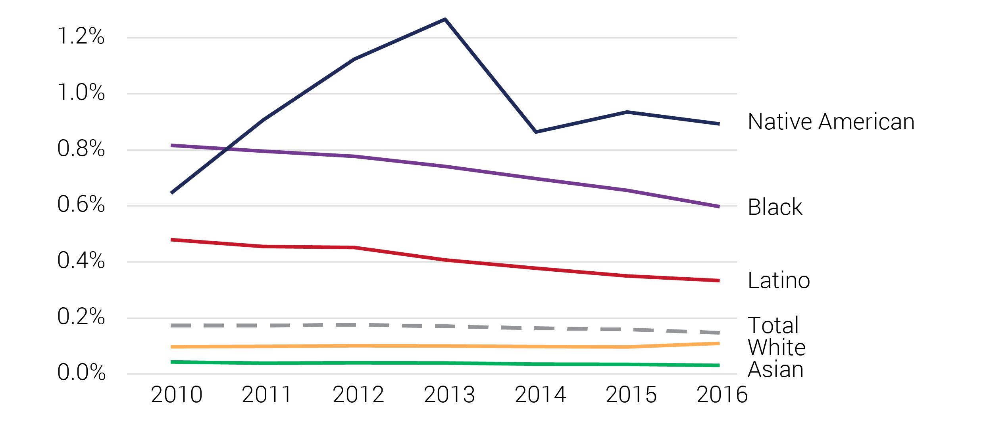
Incarceration rates
Massachusetts Department of Corrections Jurisdiction Population, as a Percent of Total Population by Race and Ethnicity
2010 through 2016, Massachusetts
Data Source: Massachusetts Department of
Corrections Inmate Characteristics by Race/Ethnicity
Notes:
Incarceration rate trends, again, show major disparities by race and ethnicity, but have generally been trending downward since 2010. This data is just for inmates in the Massachusetts Department of Corrections jurisdiction. Black and Latino inmates are severely overrepresented in these facilities, and as you can see here, Native Americans have the highest rate of incarceration, by race and ethnicity, in these facilities. We don’t have the data for it here, but national studies demonstrate that there are additional marginalized groups that are overrepresented in the prison system, including low-income people, people with disabilities, the homeless, and LGBTQ+ people.
Research also suggests that the main drivers of disparities in incarceration rates are inequitable access to resources, rigid and inflexible legislation (eg; mandatory minimums), and discrimination in policing and sentencing.
Incarceration severely limits job, housing, and educational opportunities for former inmates, and encounters with the criminal justice system can have long-term impacts on earning power and employability, as well as mental and physical health. As inmates leave the system they need support to reenter life outside.

Slide 23
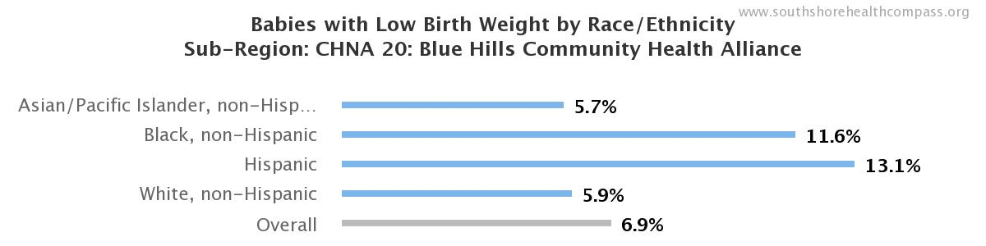
Birth Outcomes: Low Birth Weight
Within the CHNA 20 community, 7.4% more hispanic babies and 5.9% more Black (non-hispanic) babies are born at a low birth weight compared to their White counterparts.
Notes:
Within the CHNA 20 community, 7.4% more hispanic babies, and 5.9% more Black (non-hispanic) babies are born at a low birth weight compared to their White counterparts.

Slide 24
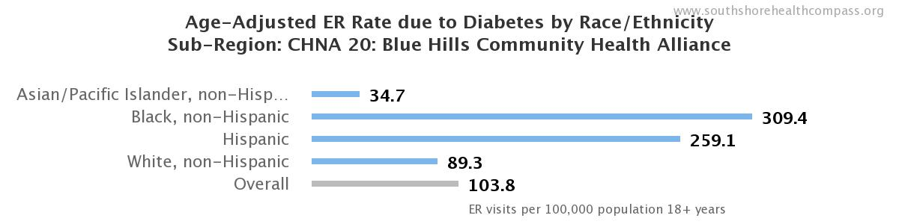
Diabetes
Within the CHNA 20 community, the ER rate due to diabetes is 3.9 times higher for Black (non-hispanic) residents, and 2.9 times higher for Hispanic residents compared to their White counterparts
Notes:
http://www.mass.gov/eohhs/gov/departments/dph/programs/community-health/diabetes/massachusetts-diabetes-data.html

Slide 25
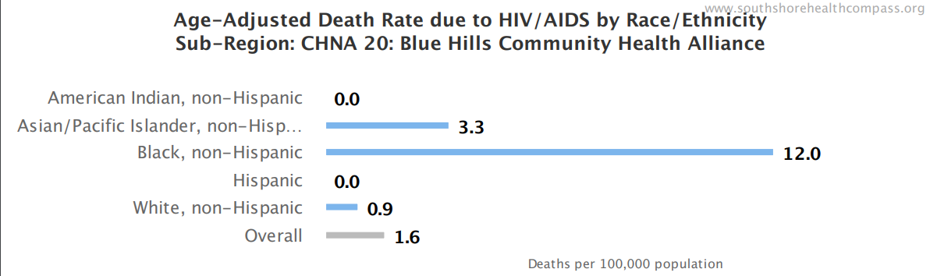
HIV/AIDS
Within the CHNA 20 community, the death rate due to HIV/AIDS is 13.3 times higher for Black (non-hispanic) residents, and 3.6 times higher for Asian/Pacific Islander residents compared to their White counterparts.
Notes:
http://www.mass.gov/eohhs/docs/dph/aids/2016-profiles/epidemic-glance.pdf

Slide 26
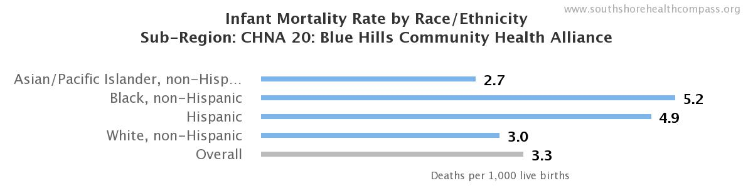
Birth Outcomes: Infant Mortality
Within the CHNA 20 community, compared with white residents , the infant mortality weight is approximately 1.7 times higher among Black (non-hispanic) and 1.6 times higher among Hispanic residents.

Slide 27
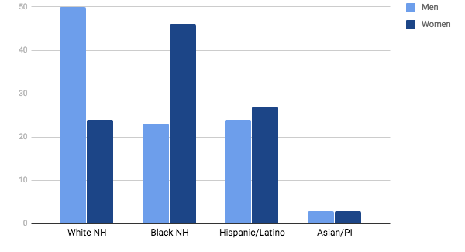
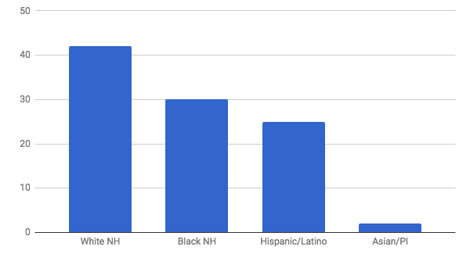
Among 14,439 men living with HIV in MA:
50% are white (non-Hispanic),
23% are black (non-Hispanic)
24% are Hispanic/Latino.
Among 5,833 women living with HIV in MA:
24% are white (non-Hispanic)
46% are black (non-Hispanic)
27% are Hispanic/Latina.
Among the 20,272 people living with HIV in Massachusetts (2015):
42% are White (non-Hispanic)
30% are Black (non-Hispanic)
25% are Hispanic/latino
2% are Asian/Pacific Islander

Slide 28
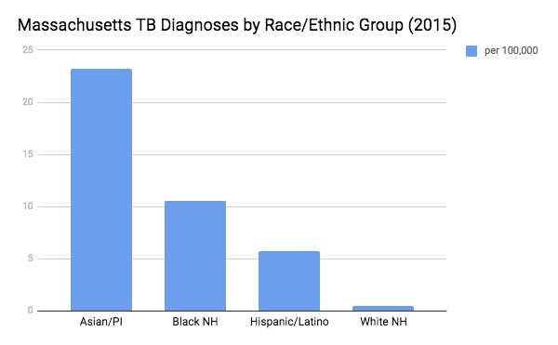
Tuberculosis
Racial/ethnic minorities are disproportionately affected by TB. Compared with white residents, the relative risk of being diagnosed with TB in 2015 was approximately 50.8 times higher among Asian/PI, 23.2 times higher among Black (non-Hispanic) and 12.6 times higher among Hispanic residents.
Notes:
http://www.mass.gov/eohhs/docs/dph/cdc/tb/summary-data-2015.pdf
http://www.mass.gov/eohhs/docs/dph/cdc/reporting/hbv-annual-report-2016.pdf

Slide 29
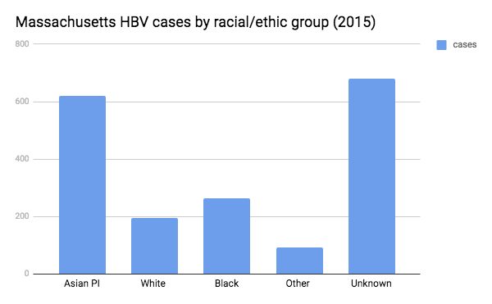
Hepatitis B
Compared to their white counterparts, the relative risk of HBV diagnosis is approximately 3.2 times higher among Asian/PI residents.

Slide 30
What can we do?

Slide 31
What can we do:
Address and Contextualize Racism
Address Race and Ethnicity Directly
As an underlying cause of disparities, documents should explore whether disparities vary by race/ethnicity and if they do, address racism directly.
Determine Appropriate Framing & Provide Context
Depending on who your audience is, consider telling a person’s story. A story can be a very effective tactic to help frame why race/ethnicity data is important.
Place racial health disparities or inequities in the context of social determinants of health and structural racism to motivate collective action, beyond individual responsibility.
Use Visuals
Graphics break down complex concepts and trends and can therefore be very useful communication tools. Utilize visualizations to communicate the connections between race and health in a way that’s compelling, accessible, and easy to understand.
Notes:
ADDRESS & CONTEXTUALIZE RACISM
Address Race and Ethnicity Directly
As an underlying cause of disparities, documents should explore whether disparities vary by race/ethnicity and if they do, address racism directly.
Always include a clear definition of race/ethnicity. Clearly define what race means in the context of decision making and justifying its inclusion as an indicator help answer the question “what does data on race tell us”. This is critical to help guide the appropriate interpretation of these data, as well as resulting recommendations.
Analyze racial implications in health impact assessments, or other similar efforts, which attempt to predict the health impact of programs or policies.
Determine Appropriate Framing & Provide Context Depending on who your audience is, consider telling a person’s story. A story can be a very effective tactic to help frame why race/ethnicity data is important.
Place racial health disparities or inequities in the context of social determinants of health and structural racism to motivate collective action, beyond individual responsibility.
Provide a convincing argument to catalyze future action. This can be accomplished by presenting data in a way that shows the need for further research to clearly understand the racial implications of proposed policies and guide recommended actions to address racial health disparities or unintended consequences.
Use Visuals Graphics break down complex concepts and trends and can therefore be very useful communication tools. Utilize visualizations to communicate the connections between race and health in a way that’s compelling, accessible, and easy to understand.

Slide 32
What can we do:
Use Available Race and Ethnicity Data
Present and Meaningfully Interpret Race/Ethnicity Data
Present racial data stratified by income, education, and/or other variables related to socioeconomic status. This is critical as some of the disparities between race/ethnic groups are due to these variables. Stratifying by these variables allows for a clearer view of how race is related to outcomes.
If primary data is unavailable or unreliable to explore nuances in subgroup variations, consider referencing special issue reports and qualitative data, such as surveys and interviews.
Early Childhood
Incorporate data on pregnant individuals and young children. Overwhelming evidence shows that gestation and early childhood are the most formative periods of life from a health standpoint.
Notes:
UTILIZE AVAILABLE RACE/ETHNICITY DATA
Present and Meaningfully Interpret Race/Ethnicity Data
Clearly explain why race is included as an indicators race and find data to support your explanation.
Always present racial data stratified by income, education, and/or other variables related to socioeconomic status. This is critical as some of the disparities between race/ethnic groups are due to these variables. Stratifying by these variables allows for a clearer view of how race is related to outcomes.
Articulate any observed sub-population variations within racial/ethnic groups, due to nationality or ancestry, whenever possible. Be mindful not to obscure disparities one subgroup may experience but the other does not. Consider the experiences of people of color with other marginalized identities (i.e.; immigration status or sexual orientation) and the historical and cultural context of variations within racial/ethnic groups (i.e.; East Asians versus Pacific Islanders).
If primary data is unavailable or unreliable to explore nuances in subgroup variations, consider referencing special issue reports and qualitative data, such as surveys and interviews.
Be careful not to make or mislead the reader by making causal interpretations based only on variations in race-related indicators. State what the data shows, and provide additional references to data or reports that discuss causation.
Find Consistent & Accurate Data We recommend using data from a single source, such as the Census and American Community Survey, throughout a document as it is likely be more reliable than racial indicators based on different data sources.
Explicitly address the limitations of the source data as well as any potential bias to avoid misinterpretation.
Take into consideration variations in classification and measurement of race that may exist between different datasets and/or across time when making comparisons.
Early Childhood
Incorporate data on pregnant individuals and young children. Overwhelming evidence shows that gestation and early childhood are the most formative periods of life from a health standpoint. To reduce disparities for subsequent generations, we must measure experiences at this stage. This includes the incorporation of data and related projections for children as well as individuals who are pregnant.

Slide 33
What can we do:
Discuss and Respond to the Drivers of Race-Based Differences
Use additional indicators and data to contextualize health inequities
Analyze additional indicators that are drivers of race-based health disparities, such as:
  Income, Segregation, Educational Attainment
  Transportation Access, Food Access, Open Space Access
  Employment/Occupation
Practice interdisciplinary and systems thinking
Discuss both upstream causes and downstream observations by connecting health disparities and race-based differences to their root causes. Discuss how the social determinants of health and policy influence one another.
Consider how existing practices, policies, and programs influence observed health disparities and how emerging practices, policies, and programs could be leveraged to address health disparities and inequities
Notes:
ADDRESS & CONTEXTUALIZE RACISM
Address Race and Ethnicity Directly
As an underlying cause of disparities, documents should explore whether disparities vary by race/ethnicity and if they do, address racism directly.
Always include a clear definition of race/ethnicity. Clearly define what race means in the context of decision making and justifying its inclusion as an indicator help answer the question “what does data on race tell us”. This is critical to help guide the appropriate interpretation of these data, as well as resulting recommendations.
Analyze racial implications in health impact assessments, or other similar efforts, which attempt to predict the health impact of programs or policies.
Determine Appropriate Framing & Provide Context Depending on who your audience is, consider telling a person’s story. A story can be a very effective tactic to help frame why race/ethnicity data is important.
Place racial health disparities or inequities in the context of social determinants of health and structural racism to motivate collective action, beyond individual responsibility.
Provide a convincing argument to catalyze future action. This can be accomplished by presenting data in a way that shows the need for further research to clearly understand the racial implications of proposed policies and guide recommended actions to address racial health disparities or unintended consequences.
Use Visuals Graphics break down complex concepts and trends and can therefore be very useful communication tools. Utilize visualizations to communicate the connections between race and health in a way that’s compelling, accessible, and easy to understand.

Slide 34
Resources
Tools
Race Equity Impact Assessment
Health Lens Analysis/Health Impact Assessment
Racial Equity Action Plans
Data Sources
State of Equity for Metro Boston
Southshore Compass
US Census and American Community Survey
Notes:
https://www.raceforward.org/practice/tools/racial-equity-impact-assessment-toolkit

Slide 35
Thank you!
Barry Keppard
Director of Public Health Metropolitan Area Planning Council
bkeppard@mapc.org
(617) 933-0750
http://www.mapc.org/
http://www.regionalindicators.org/

